Slide 1
Orphanage Management System
Presented by Group 5
28.11.2019
Notes:
This template can be used as a starter file to give updates for project milestones.
Sections
Right-click on a slide to add sections. Sections can help to organize your slides or facilitate collaboration between multiple authors.
Notes
Use the Notes section for delivery notes or to provide additional details for the audience. View these notes in Presentation View during your presentation.
Keep in mind the font size (important for accessibility, visibility, videotaping, and online production)
Coordinated colors
Pay particular attention to the graphs, charts, and text boxes.
Consider that attendees will print in black and white or grayscale. Run a test print to make sure your colors work when printed in pure black and white and grayscale.
Graphics, tables, and graphs
Keep it simple: If possible, use consistent, non-distracting styles and colors.
Label all graphs and tables.
1

Slide 2
Team Members
1119112048 Pan Ei San
1119112039 May Su Kyi Naing
1119112034 Nwe Nwe Htun
1119112045 Wai Phyo Hlaing
1119112047 Swe Zin Aung
1119113001 Thaw Tar Win Pyae
1119113003 Swe Zin Lynn Lett

Slide 3
Outline
Abstract
Introduction
Objectives
Project Scope
Drawback for existing system
Advantages
System Requirements
System Flow Diagram
Use case Diagram
ER Diagram
Conclusion

Slide 4
Abstract
Orphanage Management System (OMS) is designed as simple as possible which emphasizes on two processes : adoption and donation.
Adopter can submit the adoption form 24/7 on this web-based system.
User can make a donation easily without any difficulties, provided donation plans.
OMS will change the conventional manual management to a computerized management.
Notes:
What is the project about?
Define the goal of this project
Is it similar to projects in the past or is it a new effort?
Define the scope of this project
Is it an independent project or is it related to other projects?
* Note that this slide is not necessary for weekly status meetings
4

Slide 5
Introduction
Orphanage is a residential institution, or group home, devoted to the care of orphans and other children who were separated from their biological families.
OMS system deals between orphanage, adoptive parents and donors.
This system is specially developed for providing the parents who want to adopt their desired orphans without losing time and energy.
OMS can help to submit, receive and process ‘Adoption Request’ form.
The user can donate by choosing their prefer donation plans in OMS.
Notes:
* If any of these issues caused a schedule delay or need to be discussed further, include details in next slide.
5

Slide 6
Objectives
To provide an alternative to foster care or adoption by giving orphans a community-based setting in which they live and learn
To provide detailed information concerned with the orphans for adoptive parents
To provide for users who want to donate the orphans easily
To provide easy communication between orphanage and adoptive parents
To provide for users that saves time and energy
Notes:
Duplicate this slide as necessary if there is more than one issue.
This and related slides can be moved to the appendix or hidden if necessary.
6

Slide 7
Project Scope
This system includes three main persons: orphanage, adoption parent and donor.
The orphanage can be updated orphan’s information, check the donation list and receive the adoption letter from the adoption parent.
The adoption parent can be searched the orphan who want to adopt their desire and can be viewed orphan’s detail information.
The donor can be selected the donation plan which is suitable their balance
.
Notes:
Duplicate this slide as necessary if there is more than one issue.
This and related slides can be moved to the appendix or hidden if necessary.
7

Slide 8
Drawbacks for Existing System
There is no sharing is possible if the data is in the form of paper or Disk drives.
The manual system gives us very less security for saving data; some data may be lost due to mismanagement.
It’s a limited system and fewer users friendly.
Searching of particular information is very critical it takes lot of time.
It is a tedious job to maintain different customers are asking different service details, normally solve these queries are not possible. Automated system is needed.

Slide 9
Advantages
It is a very efficient way of adopting the orphans online.
Due to its convenience, the users can be available this system from anywhere and at any time.
Can save time and energy.
Can access detailed information of the orphans at one place.
Can be reliable than donating from third-party.

Slide 10
System Requirement
Hardware requirement
A person computer (Pentium 4, 500Mhz or higher recommendation)
Minimum RAM of 500Mb
Un-interrupted Power Supply
Software requirement
Minimum of window XP
MySQL or SQL
Internet Services
Notes:
* If any of these issues caused a schedule delay or need to be discussed further, include details in next slide.
10

Slide 11
Functional Requirement
Display the information of Orphanage
Add the Orphan’s information
Check the donor and adoptive parent’s information
Define the rules for adoptive parent
Fill the adoptive parent’s information must be corrected and completed
Non-Functional Requirement
Security: Secure all the data of users and orphan and orphanage
Reliability: Orphanage, donor and adoptive parent can be reliable on OMS system because this system support the information detail for them. Orphanage can be reliable on adoptive parent about their detail information. Donor can be reliable on orphanage about donation’s balance.
Notes:
* If any of these issues caused a schedule delay or need to be discussed further, include details in next slide.
11

Slide 12
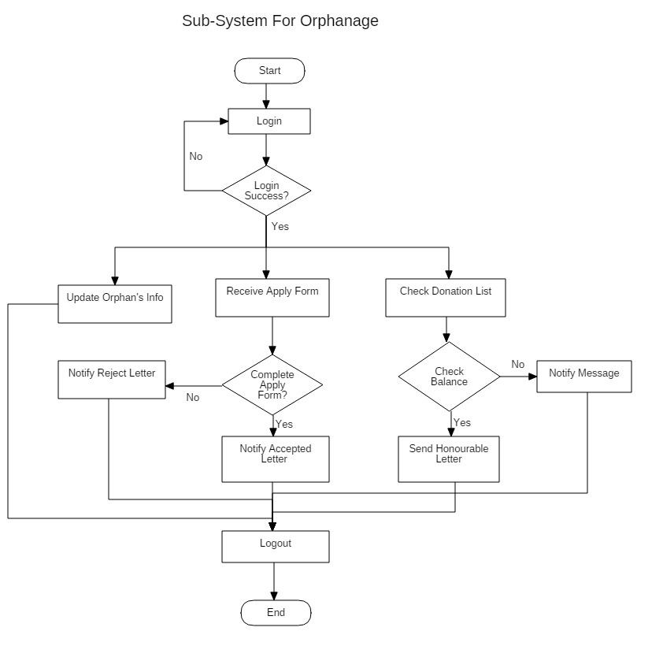
System Flow Diagram
Detail

Slide 13
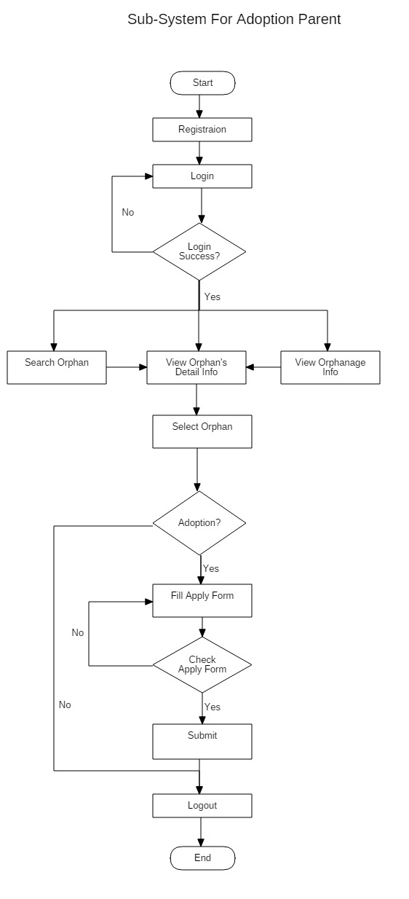
Detail

Slide 14
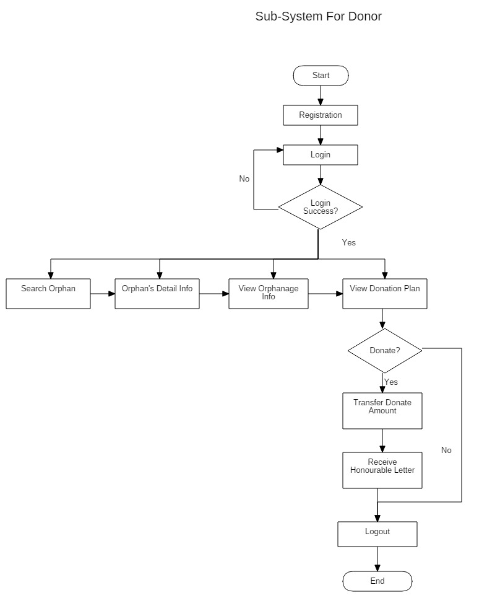
Detail

Slide 15
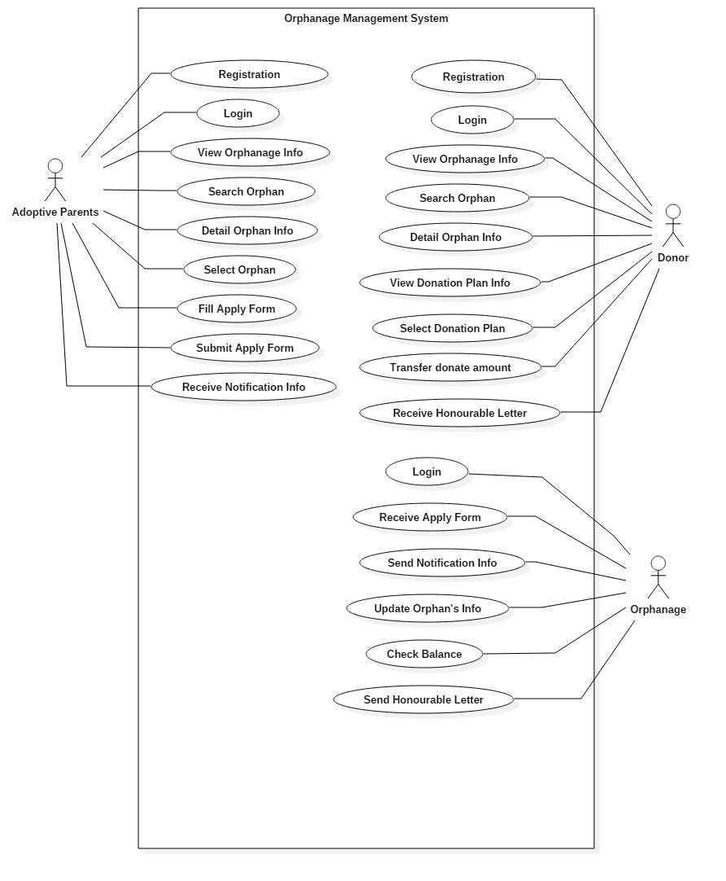
Use case Diagram
Detail

Slide 16
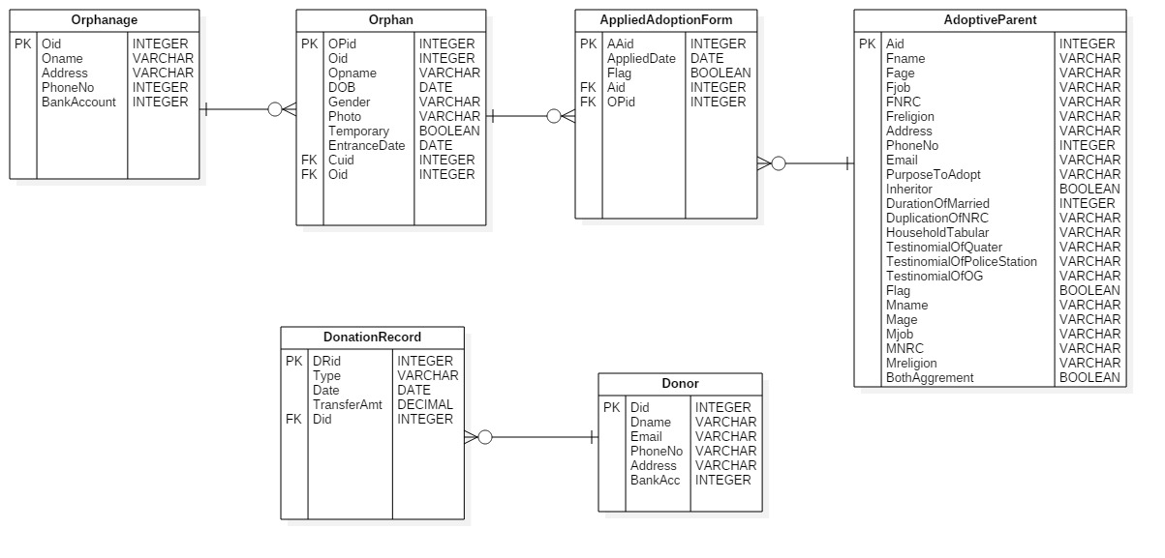
ER Diagram
Detail

Slide 17
Conclusion
The system can help an orphanage to get more donators and adopters as this is designed user-friendly and simply.
The system shows disciplines for adoptive parents to adopt a child.
Orphanage can reduce time and work load in their processes by using OMS.
Notes:
17

Slide 18
Thank you

